Slide 1




OPTINAV
SUPPORT
SOLUTIONS

Slide 2
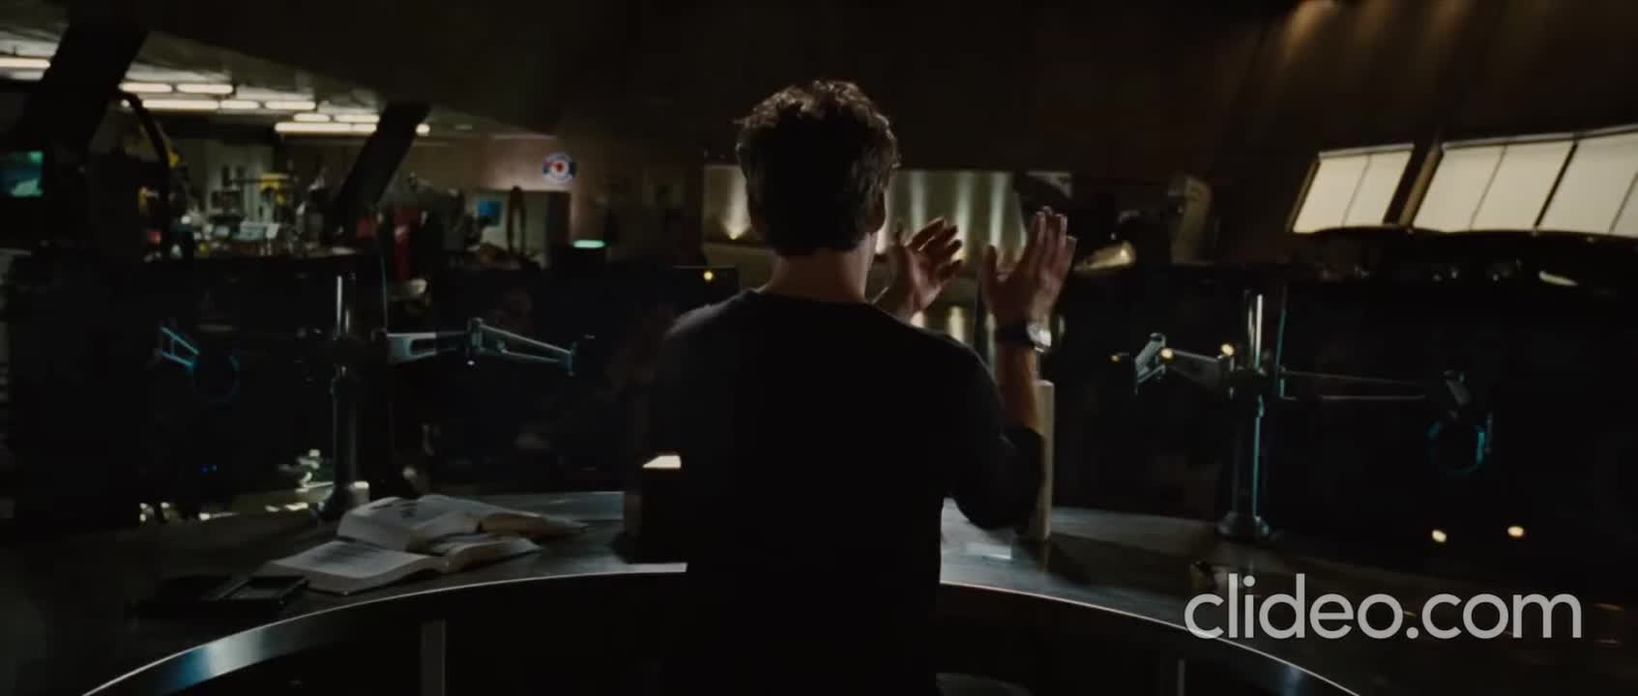

optimal AI Voice assitant copilot
Build a voice chatbot that will make the function of a copilot, by answering every question or doubt about solutions of a damage or any other issue that could happen during the mission.
Use our skills and experience in AI.
Help to prevent and fix failures by answering questions you have during a NASA mission in a swiftly, accurately, and comprehensively way.

Slide 3
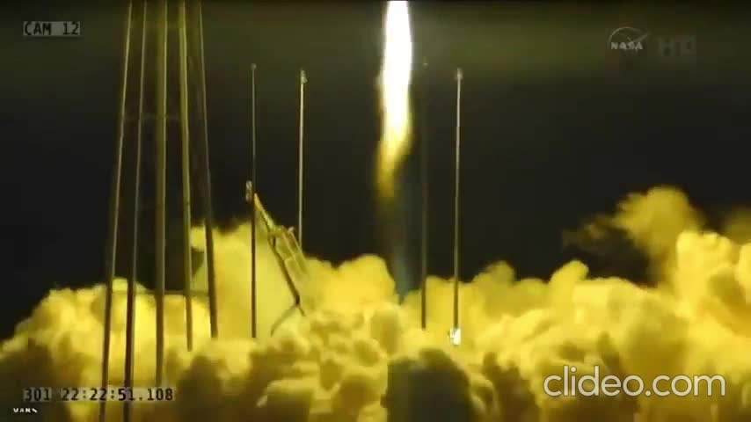
Problem
Lack of access to crucial information
The crew might struggle to access critical data such as information about life support systems, weather conditions, navigation data, or details about emergency procedures.
Slower decision-making
Delay of crucial decision-making in emergency situations, potentially increasing risks for both the crew and the spacecraft.
Potential for human errors
Increment in the likelihood of human errors in interpreting data or executing emergency procedures, potentially worsening the situation.
Lack of real-time guidance
An AI assistant could provide real-time guidance on actions to take in emergency situations, which can be essential for maintaining crew and spacecraft safety.

Slide 4

Solution ideas
Implement an AI assistant capable of answering crew questions and providing critical information instantly during emergency situations.
Develop an AI system that can quickly analyze data and provide recommendations for critical decisions, speeding up the decision-making process.
Implement an AI assistant to verify the execution of critical procedures and alert the crew in case of errors.
Develop an AI system that offers real-time guidance to the crew during emergency situations, providing precise instructions.

Slide 5
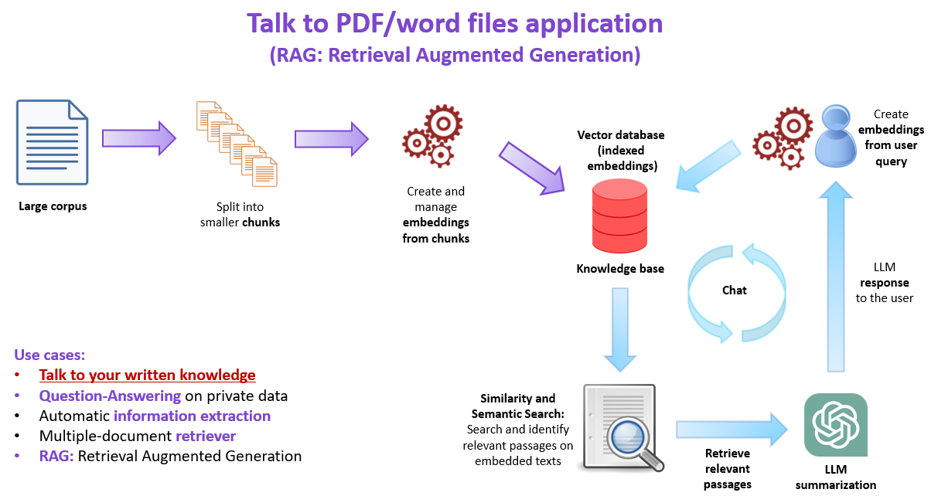


PROCESS
1- PDF NASA CHATBOT

Slide 6

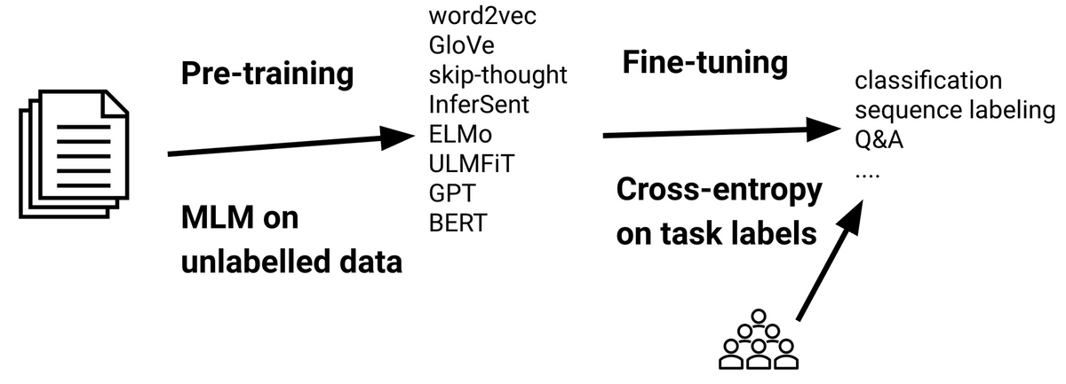
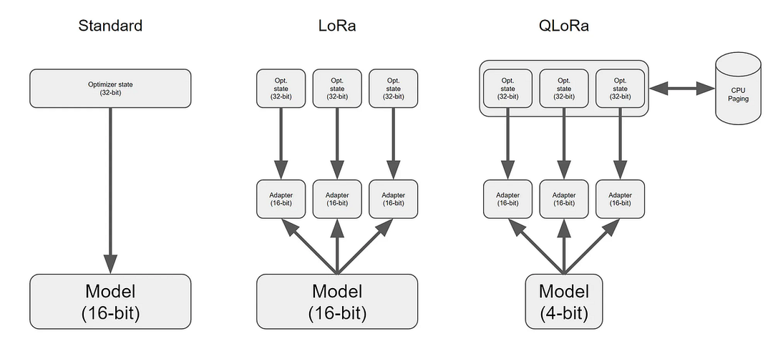

QLORA + FINE-TUNING +LL2

Slide 7
results

